Slide 1
Spring Boot Series – Day 12
Topic: Spring Security — Custom AccessDeniedHandler
&
Error Response Design
@CodeByHaindavi | #SpringWithMe

Slide 2
Why Customize AccessDeniedHandler?
✔️ In real-world apps, failures don't stop at login — even authenticated users get blocked if they try accessing something outside their role.
✔️ Spring Security’s default behavior returns an unhelpful HTML 403 page — not ideal for frontend developers working with REST APIs.
✔️ By using a custom AccessDeniedHandler, you can return structured JSON responses that include the status code, message, endpoint path, and timestamp.
✔️ This gives full control over how access issues are communicated, improving both the developer experience and the end-user clarity.
@CodeByHaindavi | #SpringWithMe

Slide 3
When Does AccessDeniedHandler Trigger?
✔️ This handler is only called after a user has successfully logged in — but then tries to access a resource they don’t have permission for.
✔️ It is not the same as AuthenticationEntryPoint, which deals with unauthenticated users (users who haven’t logged in at all).
✔️ A typical scenario: a user with ROLE_CUSTOMER tries to hit an admin-only endpoint like /admin/dashboard.
✔️ In such cases, Spring calls your custom AccessDeniedHandler, and you can return a clean 403 Forbidden JSON response with context-specific details.
@CodeByHaindavi | #SpringWithMe

Slide 4
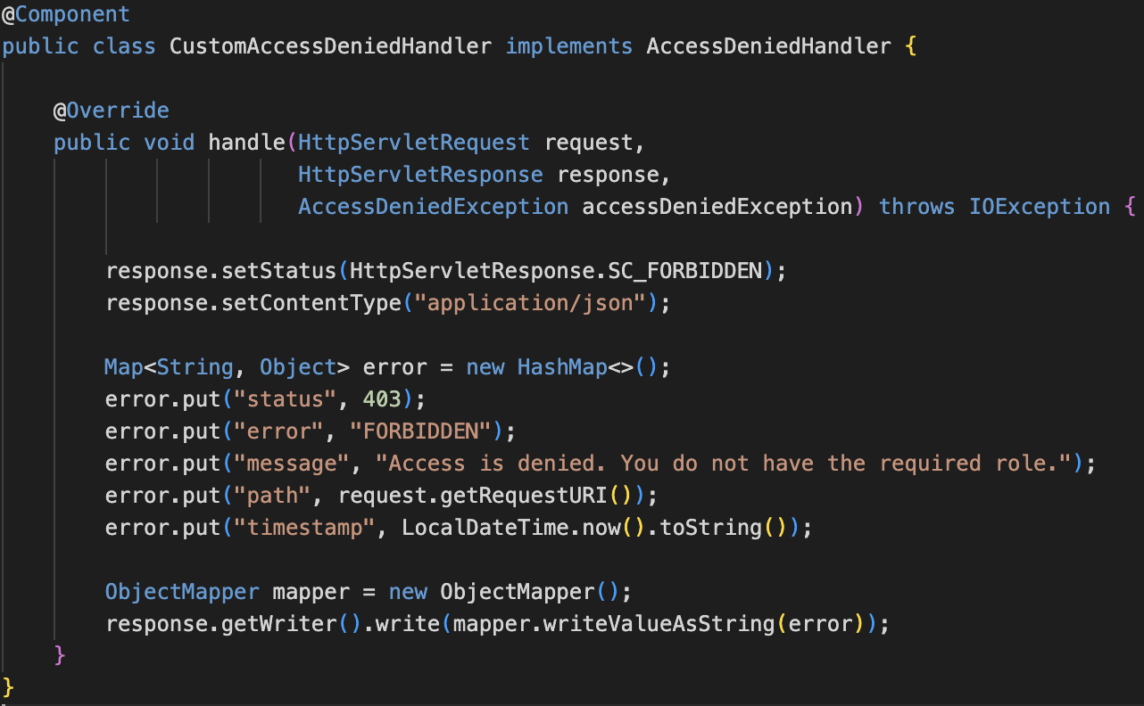
Implementing a Custom AccessDeniedHandler
✔️ The class implements AccessDeniedHandler and overrides the handle() method to take control of 403 responses.
✔️ It activates when an authenticated user tries to access a resource they don’t have permission for.
✔️ Within the handler, you build a structured JSON response containing fields like status, message, timestamp, and the requested URI.
✔️ The response is returned with HTTP status 403 and application/json content type — making it frontend-ready and easy to debug.
✔️ This allows your backend to send clear, consistent error messages instead of vague or confusing defaults.
@CodeByHaindavi | #SpringWithMe

Slide 5
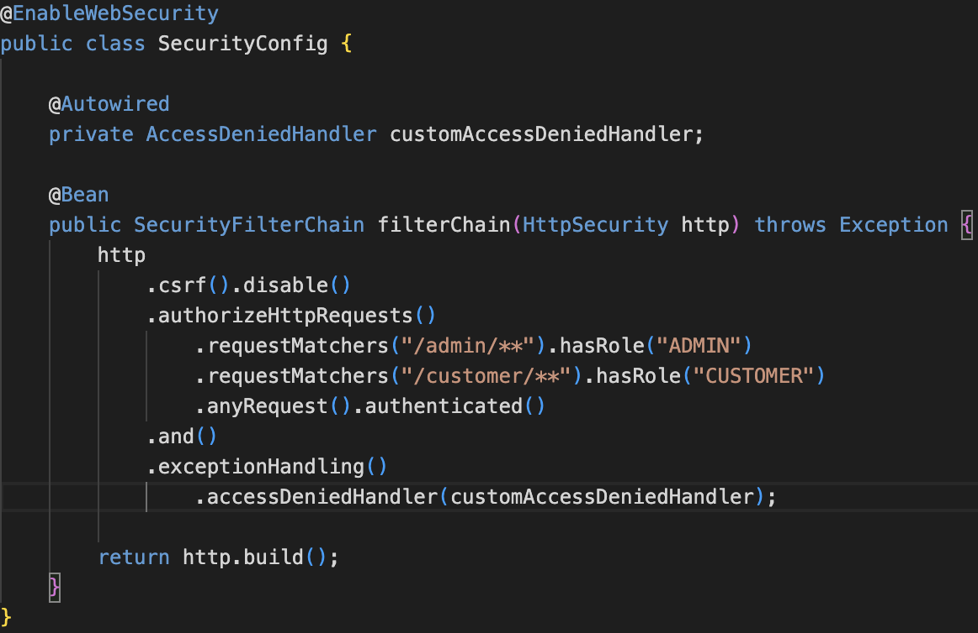
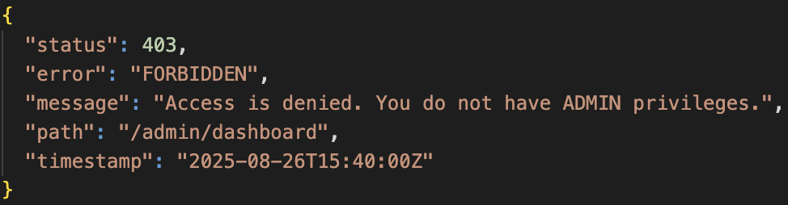
Wiring Custom Access Handling into Spring Security
✔️ Inside your SecurityConfig, use .exceptionHandling() to register the custom access denied handler.
✔️ This ensures that authenticated users who lack the required role trigger your handler instead of Spring’s default error page.
✔️ It works alongside your custom AuthenticationEntryPoint, which handles unauthenticated requests — giving you full control over both 401 and 403 responses.
@CodeByHaindavi | #SpringWithMe

Slide 6
ErrorResponse DTO Design
✔️ Define a reusable ErrorResponse class with fields like status, message, path, and timestamp — this becomes your standard error structure.
✔️ Use ObjectMapper to convert this object into a JSON response every time access is denied.
✔️ Reuse the same DTO across both your AccessDeniedHandler and AuthenticationEntryPoint to maintain consistent error formatting.
✔️ This consistency makes it easy for frontend developers to parse and display error messages — whether it's a 401 or a 403.
@CodeByHaindavi | #SpringWithMe

Slide 7
📌 Hands-On Tip
✔️ Use request.getRequestURI() to include the exact endpoint in the error response — this helps both debugging and frontend display.
✔️ Set the response status explicitly to 403 and content type to application/json — don’t rely on Spring’s defaults.
✔️ Avoid hardcoding error strings; make the message dynamic if your logic supports multiple roles or permission levels.
✔️ Structure your 403 response using a consistent ErrorResponse DTO — the same format used for 401 errors helps frontend teams handle errors uniformly.
✔️ Log access denial events including the username (if authenticated) and the endpoint — this provides clarity during audits and debugging.
@CodeByHaindavi | #SpringWithMe

Slide 8
💼 Interview Insight
How to ensure JSON error output instead of HTML in Spring Security
• Implement a custom AccessDeniedHandler for 403 and AuthenticationEntryPoint for 401, then write structured JSON using ObjectMapper.
• Set the response status and Content-Type (application/json) explicitly to override Spring’s default HTML output.
Can error payloads be customized based on roles or endpoints?
• Inside the handler, use request.getRequestURI() and authenticated user details to dynamically craft role-specific messages.
• Log denied attempts with username, path, and required roles to aid in debugging and provide traceability for audits.
@CodeByHaindavi | #SpringWithMe

Slide 9
📌 Recap – Day 12
🔐 AccessDeniedHandler controls 403 responses when an authenticated user tries to access something beyond their role.
🧠 It differs from AuthenticationEntryPoint, which handles unauthenticated access attempts (401 errors).
📦 Custom JSON responses improve both frontend display and backend observability.
⚙️ This setup strengthens security and provides full control over how access issues are communicated.
👉 Coming up next: Custom AuthenticationSuccessHandler & AuthenticationFailureHandler
@CodeByHaindavi | #SpringWithMe

